Slide 1

Learning Handwriting using EMNIST and Neural Networks
Presented by: Pete Reid

Slide 2
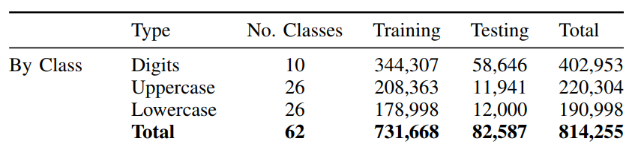
Extended Modified NIST (EMNIST)
Derived from the NIST Special Database 19, these datasets are intended to represent a more challenging classification task for neural networks and learning system.
Notes:
I was lucky enough to have a prepared dataset from the National Institute of Standards and Technology.
Changed the training / testing to 15 / 85 split
697932 / 116323

Slide 3
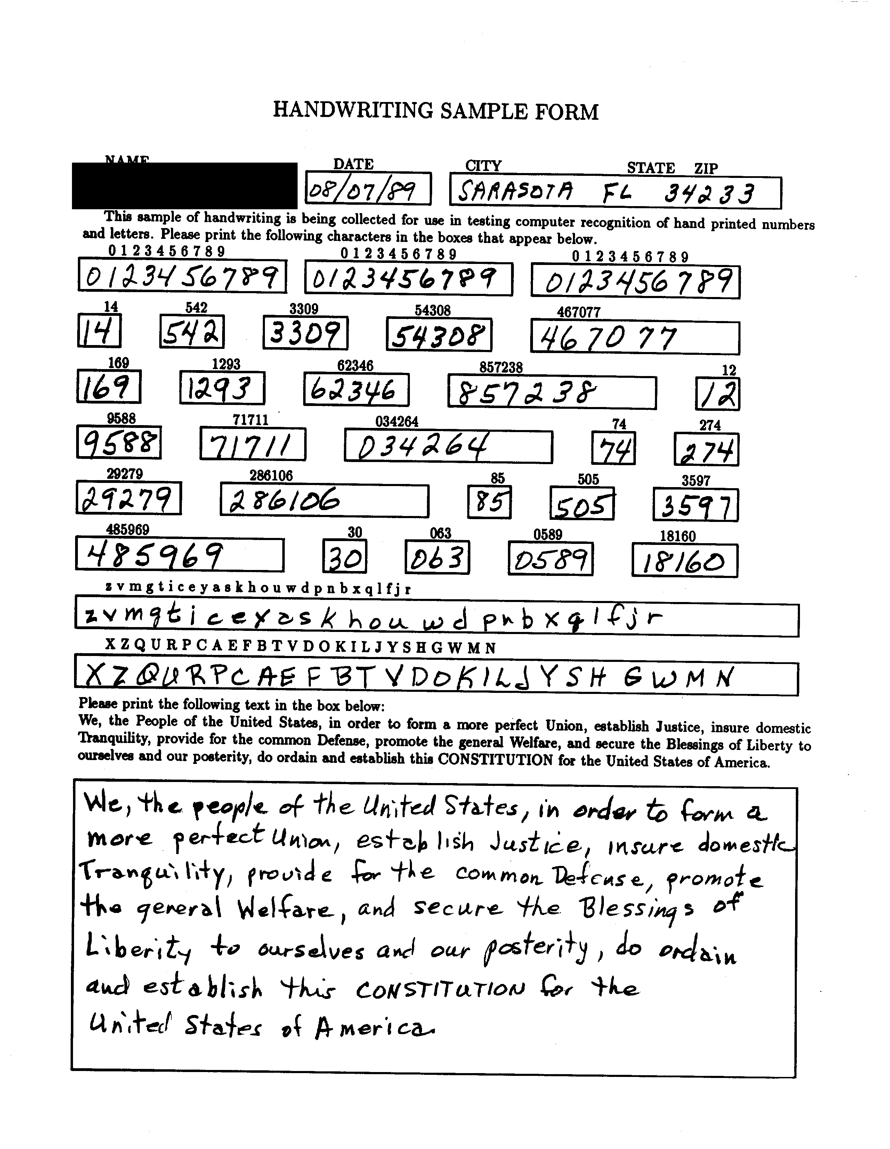
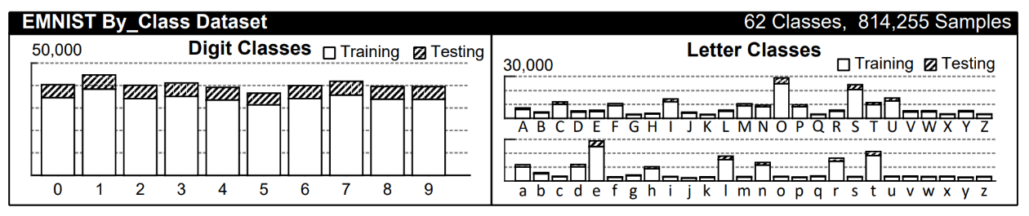
EMNIST Continued
Taken from handwriting sample forms
Using By_Class Dataset (unbalanced)
Notes:
I chose the unbalanced to see if there was some additional bias that may have helped with identifying unknown letters or numbers (most common letters would be weighted higher than uncommon ones)

Slide 4
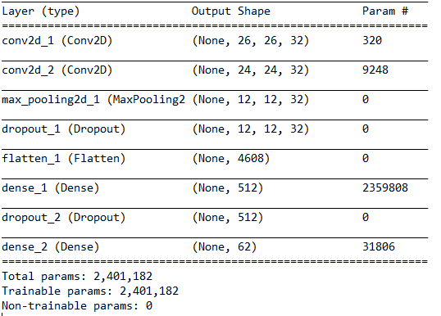
Model Summary
Notes:
Multi layer convolutional neural network
Roughly 7 different models with the highest performance being 88% after 200 epochs

Slide 5
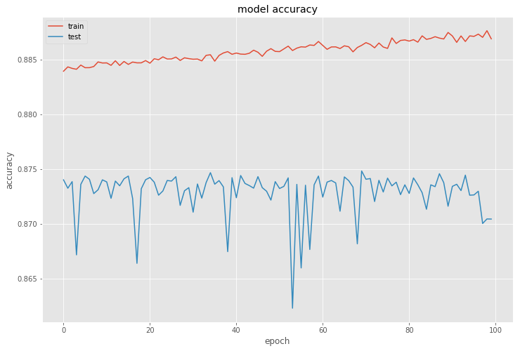
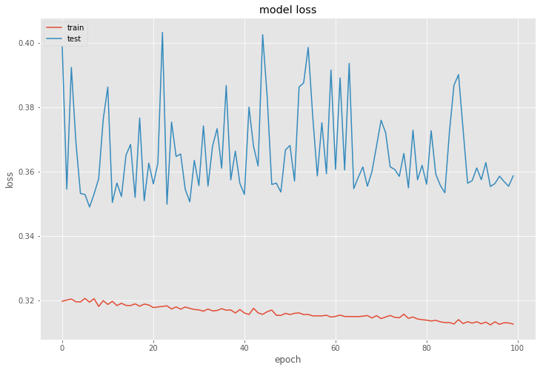
Model Summary
Epochs = 100
Batch size = 256
Test score: 0.358586772516
Test accuracy: 0.870438348392

Slide 6


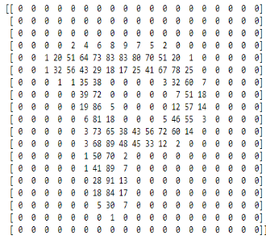
Prediction Process
Each image was 28 x 28 = 784 pixels
Applied thresholding to removed all colors except black and white
Inverted colors to determine where pixels were
Ran each image through the model to predict letter
Notes:
Split the model into a reusable file

Slide 7
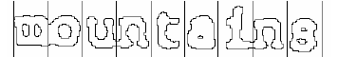
Next Steps
OpenCV
Using contours to breakout each digit or letter and return value
Run across multiple forms and return values to output
Record dataset to build additional model to determine document type
Uses
Audit (full sample testing)
Record retention and identification

Slide 8
Lessons Learned
GPU Performance (50 mins per epoch vs 50 sec)
Broken characters are difficult to assess (j i , . )
Similar letters/digits can be hard to predict without context
(I=l=1)
(0=O)
(B=H)
(P=R)
Context may improve performance
Multiple models based on the context of the data will result in higher accuracy
Digit models (MNIST performs better without letters) 99% + Accuracy
Notes:
50 / 60 times faster
Tensorflow_gpu

Slide 9
Questions

